Slide 1


Javier Contreras
22-11-2022

Slide 2

Outline
Executive Summary
Introduction
Methodology
Results
Conclusion
Appendix

Slide 3
Executive Summary
Summary of methodologies
Data Collection with SpaceX API and web scraping
Data analysis with SQL, data visualization and interactive dashboard
Machine Learning predictions
Summary of all results
Exploratory data analysis
Predictive analysis

Slide 4
Introduction
The objective of this project is to predict if the SpaceX Falcon 9 rocket first stage will land successfully in order to determine the cost of launch. So, if another space company wants to bid against them for a rocket launch, they can use these predictions.
Principal problems:
Identify the relation of all the variables that affects the outcome
What is the best classification model to predict the outcome?

Slide 5

Section 1

Slide 6
Methodology
Executive Summary
Data collection methodology:
SpaceX Rest API
Web Scraping
Perform data wrangling
Filtering Falcon 9 cases
Missing values
One-hot encoding to categorical variables

Slide 7
Methodology
Perform exploratory data analysis (EDA) using visualization and SQL
Perform interactive visual analytics using Folium and Plotly Dash
Perform predictive analysis using classification models
The data was normalized, splitted in train and test data sets and using GridSearch to find the best hyperparameters the data was trained with Classification Models such as Logistic Regression, Support Vector Machine, Decision Tree and K-Nearest Neighbors.

Slide 8
Data Collection
The data was collected from:
SpaceX REST API using the get request and turning the content to a Pandas Dataframe.
Wikipedia using BeautifulSoup extracting the records as an HTML table, parsing it and converting it to a Pandas Dataframe

Slide 9
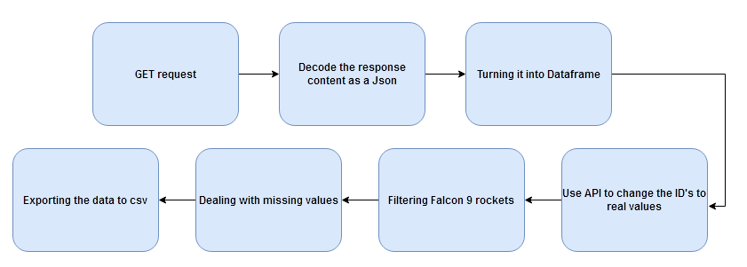
Data Collection – SpaceX API
GitHub code: https://github.com/javier-icvds/Applied-Data-Science-Captsone/blob/main/jupyter-labs-spacex-data-collection-api.ipynb

Slide 10
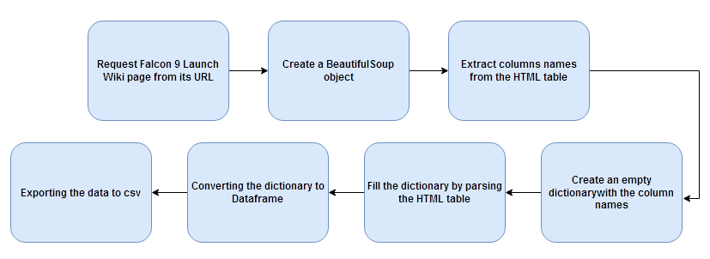
Data Collection - Scraping
GitHub code: https://github.com/javier-icvds/Applied-Data-Science-Captsone/blob/main/jupyter-labs-webscraping.ipynb

Slide 11
Data Wrangling
Exploratory Data Analysis was performed to find patterns and to determine the label of the Supervised models.
The number of launches on each site, number and occurrence of each orbit and mission outcome type were calculated.
The values of the “Outcome” variable were used to create a new variable “Class” equal to 1 if it was a successful landing or 0 unsuccessful landing.
GitHub code: https://github.com/javier-icvds/Applied-Data-Science-Captsone/blob/main/labs-jupyter-spacex-Data%20wrangling.ipynb

Slide 12
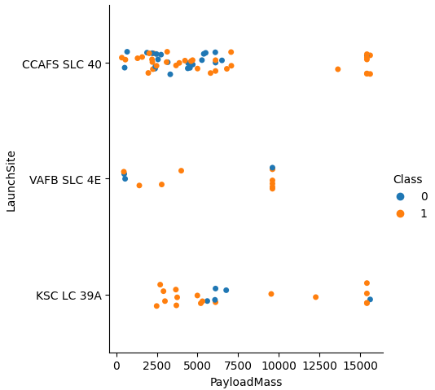
EDA with Data Visualization
The charts were plotted to identify patterns between features, those are:
FlightNumber vs PayloadMass, FlightNumber vs LaunchSite, PayloadMass vs LaunchSite, success rate of each orbit type, FlightNumber vs Orbit, PayloadMass vs Orbit, launch success yearly trend.
GitHub code: https://github.com/javier-icvds/Applied-Data-Science-Captsone/blob/main/jupyter-labs-eda-dataviz.ipynb

Slide 13
EDA with SQL
SQL queries
Display the names of the unique launch sites in the space mission.
Display 5 records where launch sites begin with the string.
Display the total payload mass carried by boosters launched by NASA (CRS).
Display average payload mass carried by booster version F9 v1.1.
List the date when the first successful landing outcome in ground pad was achieved.
List the names of the boosters which have success in drone ship and have payload mass greater than 4000 but less than 6000.
List the total number of successful and failure mission outcomes.
List the names of the booster_versions which have carried the maximum payload mass.
List the records which will display the month names, failure landing_outcomes in drone ship ,booster versions, launch_site for the months in year 2015.
Rank the count of successful landing_outcomes between the date 04-06-2010 and 20-03-2017 in descending order.
GitHub code: https://github.com/javier-icvds/Applied-Data-Science-Captsone/blob/main/jupyter-labs-eda-sql-coursera_sqllite.ipynb

Slide 14
Build an Interactive Map with Folium
The following map objects were added to the folium map:
Markers: indicates launch sites.
Circles: highlighted area with a text label.
Lines: indicate distances between coordinates.
Marker clusters: success/failed launches on each launch site.
Green mark: success
Red mark: failed
GitHub code: https://github.com/javier-icvds/Applied-Data-Science-Captsone/blob/main/lab_jupyter_launch_site_location.ipynb

Slide 15
Build a Dashboard with Plotly Dash
Searchable dropdown list to filter by a specific launch site.
Pie chart showing the total success launches per-site.
Slider to select a payload range.
Scatter plot Payload Mass vs class by Booster Version category.
GitHub code: https://github.com/javier-icvds/Applied-Data-Science-Captsone/blob/main/plotly%20dash.py

Slide 16
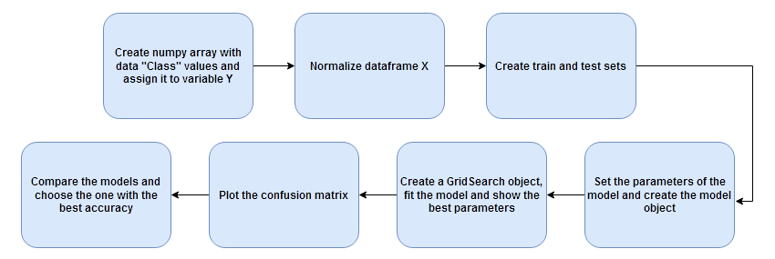
Predictive Analysis (Classification)
GitHub code: https://github.com/javier-icvds/Applied-Data-Science-Captsone/blob/main/SpaceX_Machine%20Learning%20Prediction_Part_5.ipynb

Slide 17

Results
Exploratory data analysis results
Interactive analytics demo in screenshots
Predictive analysis results

Slide 18

Section 2

Slide 19
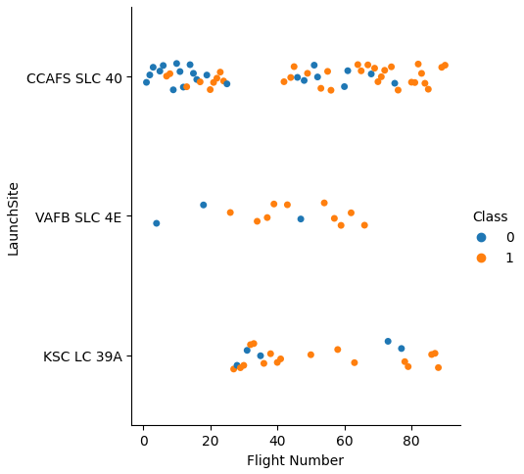
Flight Number vs. Launch Site
Early launches were unsuccessful while the latest were successful.
As the time goes by, the launches are more likely to succeed.

Slide 20
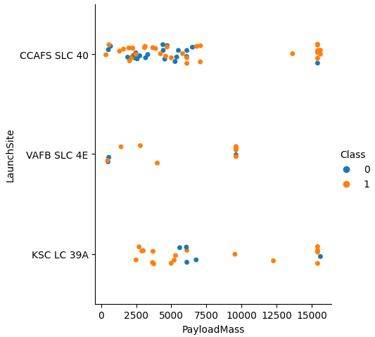
Payload vs. Launch Site
Launches with a higher payload mass are in majority succeed.
KSC LC 39A have a high probability to succeed in payloads mass below 6000.

Slide 21
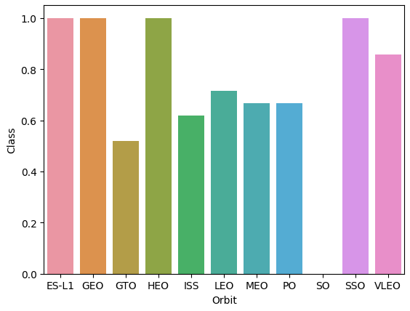
Success Rate vs. Orbit Type
Orbits with 100% success rate
ES-L1, GEO, HEO, SSO
Orbit SO with 0% success rate
Followed by VLEO(~88%), LEO (~70%), MEO and PO (~66%), ISS (~61%), HEO (~55%).

Slide 22
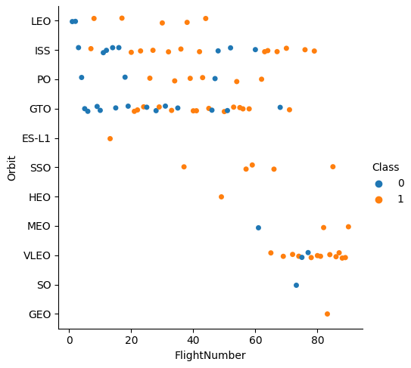
Flight Number vs. Orbit Type
Success rate improves as time goes by.
VLEO is the most attractive orbit to ensure a successful launch due to its frequency launches and succeed rate.
ES-L1, HEO, MEO, SO, GEO should not be considered because they have very few records.

Slide 23
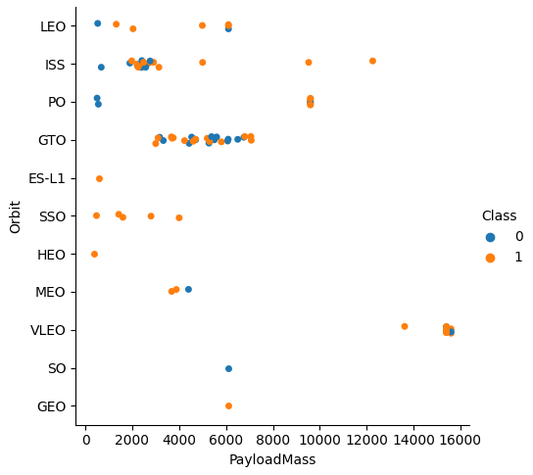
Payload vs. Orbit Type
The success rate increases significantly when the payload mass is greater than aprox. 9000 for ISS, PO anda VLEO.
For orbit SSO the success rate is 100% for payload mass lower than 4000.
For orbit VLEO the success rate is higher when the payload mass is greater than 13000.

Slide 24
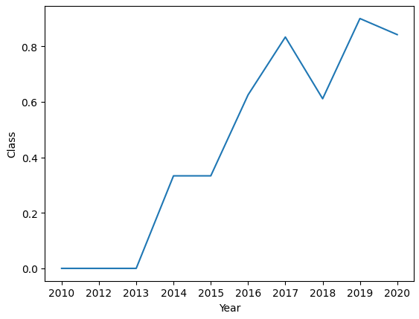
Launch Success Yearly Trend
The success rate has increased since 2013 from 0% to 80% in 2020.

Slide 25
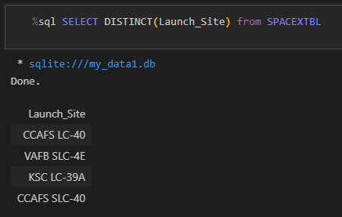
All Launch Site Names
The names of all site names are the following:

Slide 26
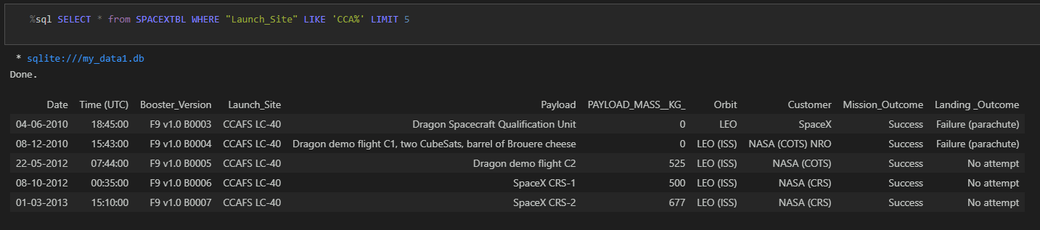
Launch Site Names Begin with 'CCA'
5 records where launch sites begin with `CCA`:

Slide 27
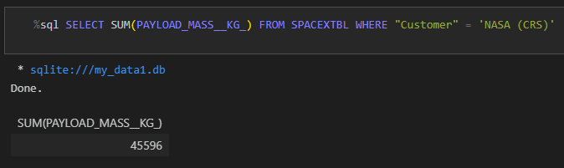
Total Payload Mass
Total payload carried by boosters from NASA (CRS):

Slide 28
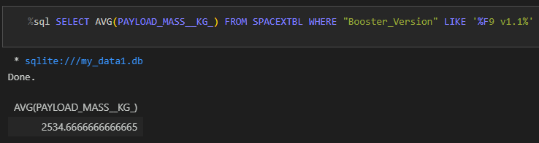
Average Payload Mass by F9 v1.1
Average payload mass carried by booster version F9 v1.1:

Slide 29
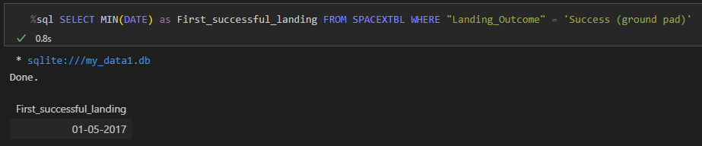
First Successful Ground Landing Date
First successful landing outcome on ground pad:

Slide 30
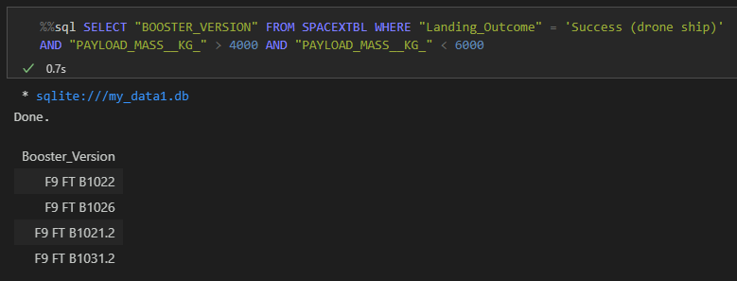
Successful Drone Ship Landing with Payload between 4000 and 6000
Names of boosters which have successfully landed on drone ship and had payload mass greater than 4000 but less than 6000:

Slide 31
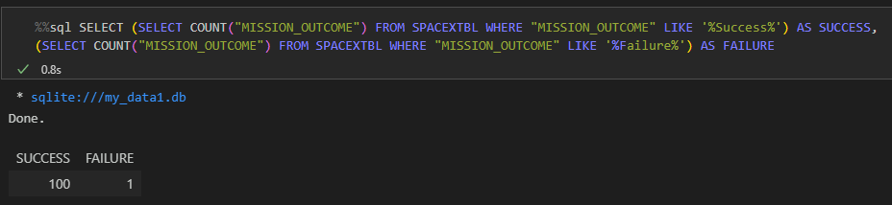
Total Number of Successful and Failure Mission Outcomes
Total number of successful and failure mission outcomes:

Slide 32
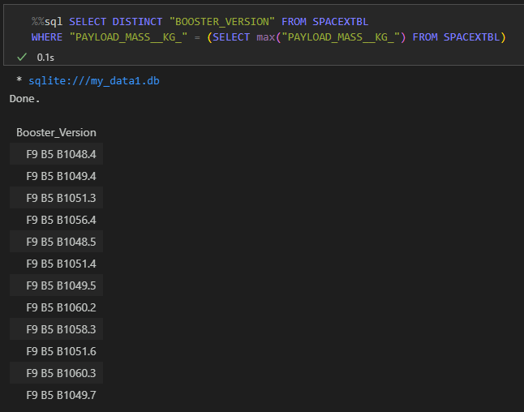
Boosters Carried Maximum Payload
Names of the booster which have carried the maximum payload mass:

Slide 33
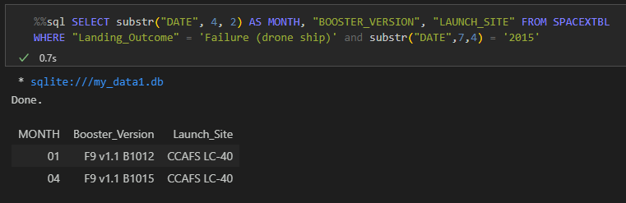
2015 Launch Records
Failed landing_outcomes in drone ship, their booster versions, and launch site names for in year 2015:

Slide 34
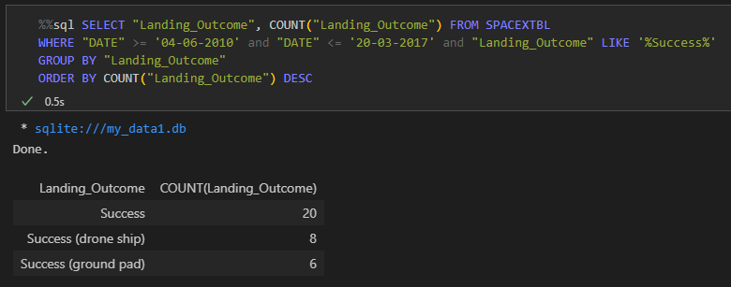
Rank Landing Outcomes Between 2010-06-04 and 2017-03-20
Rank the count of landing outcomes (such as Failure (drone ship) or Success (ground pad)) between the date 2010-06-04 and 2017-03-20, in descending order:

Slide 35

Section 3

Slide 36
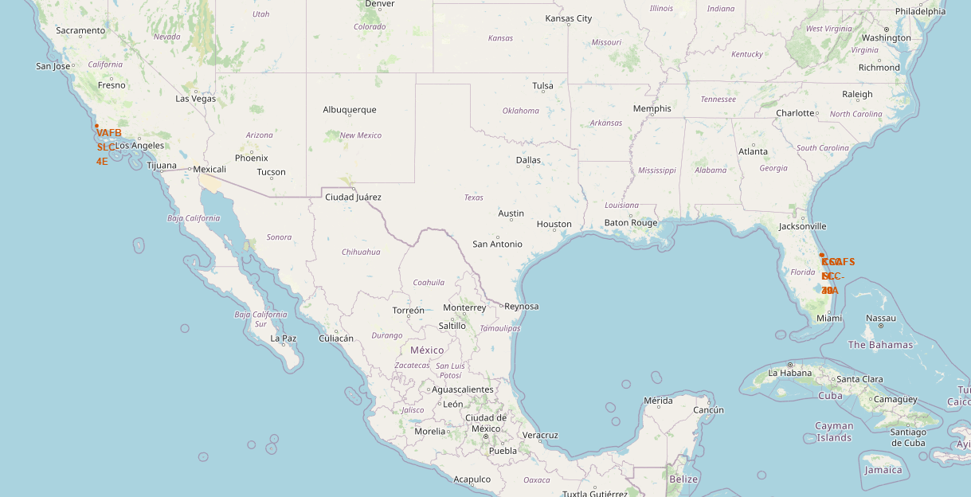
Launch Site Locations
All the locations are nearly the sea.

Slide 37
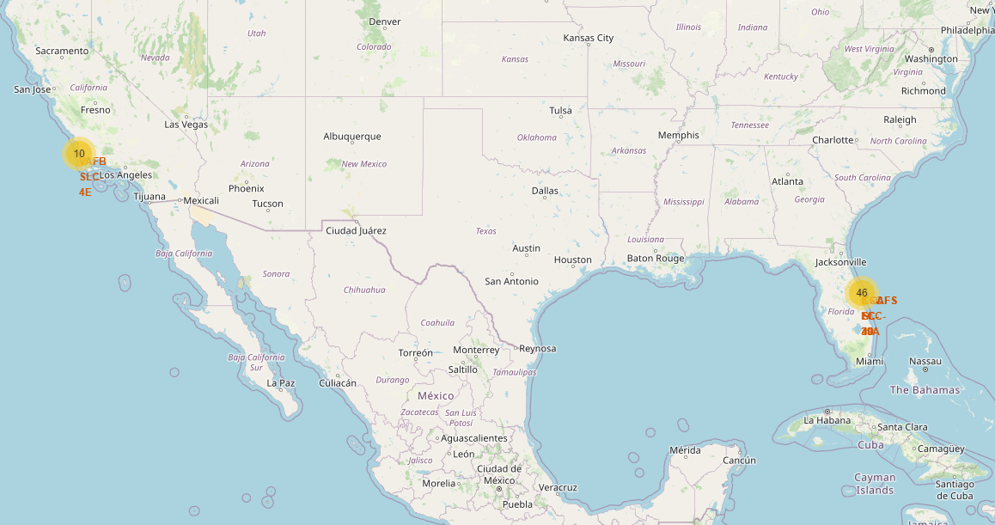
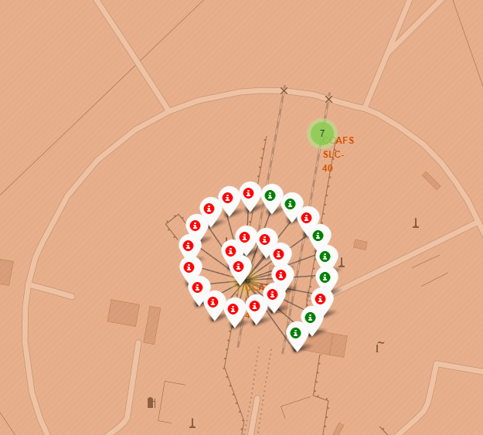
Launch outcomes by launch site
Green markers show successful launches and red markers unsuccessful launches.

Slide 38
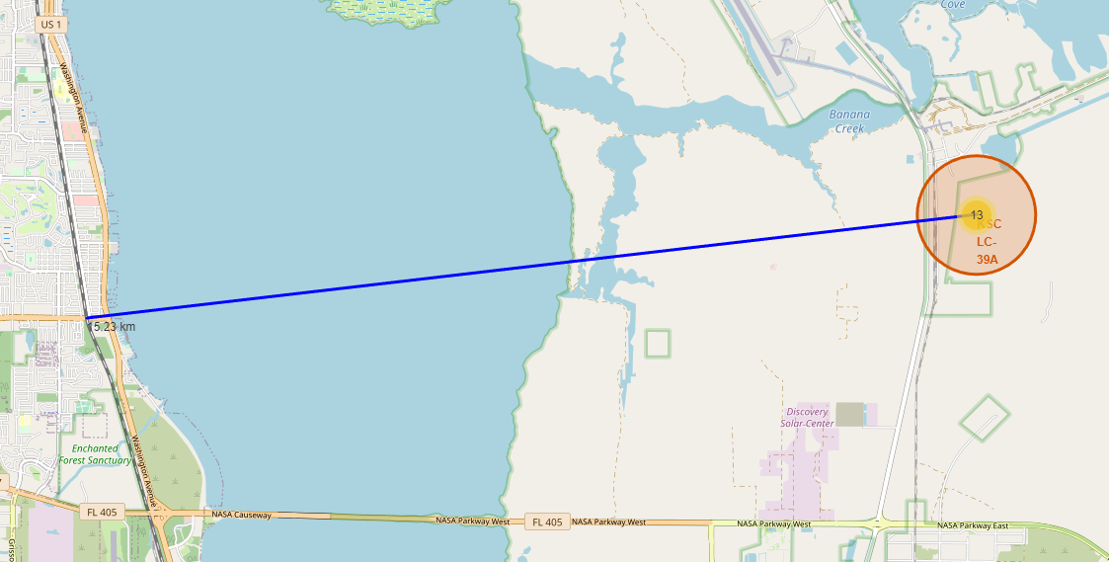
Proximity to surrounds
The launch proximity of KSC LC-39A launch site to the nearest railway is 15.23 km.

Slide 39

Section 4

Slide 40
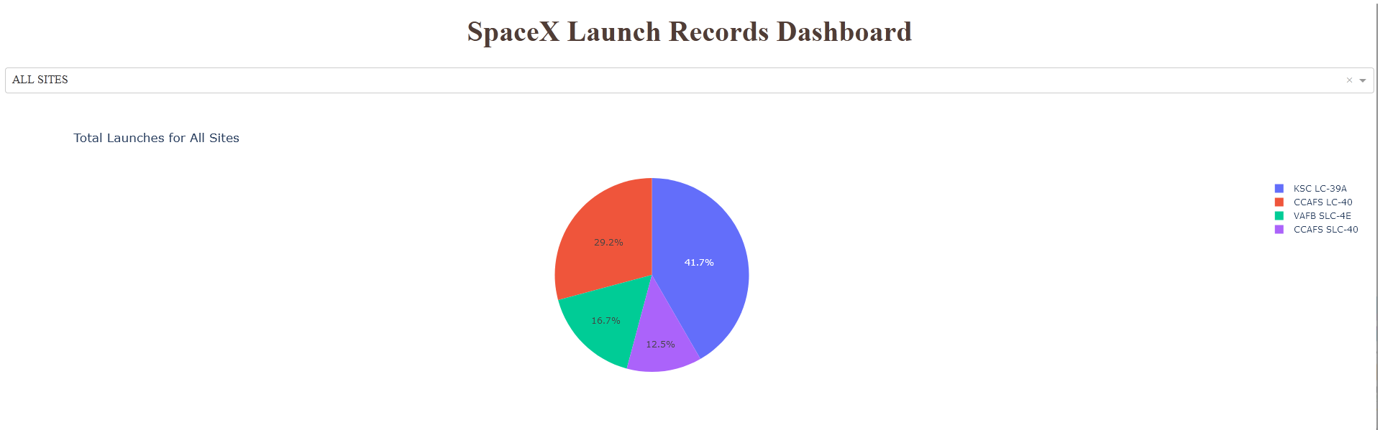
Launches ratio per launch site
As we can observe, KSC LC-39A has the higher launch rate with 41.7% of the total launches.

Slide 41
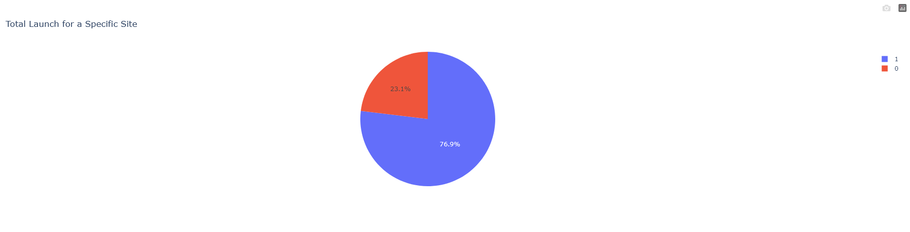
Launches success ratio for KSC LC-39A
KSC LC-39A has a launch success probability of 76.9%.

Slide 42
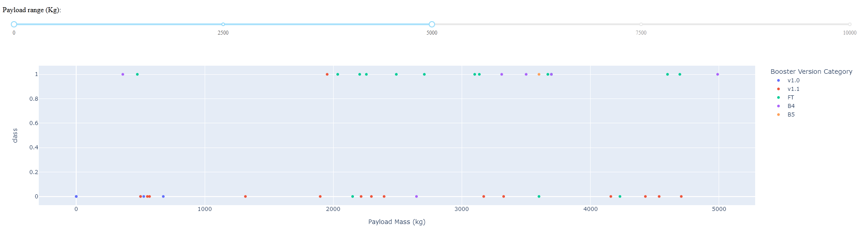
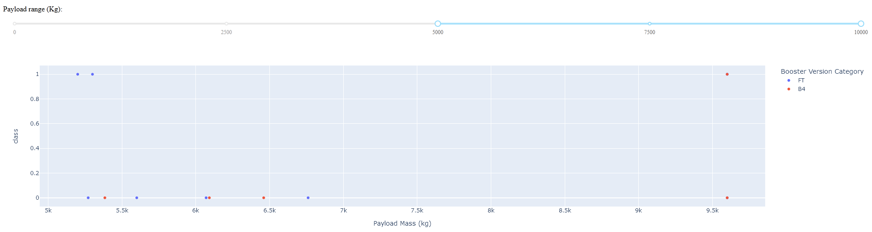
Outcome with different payload
Payloads mass between 2500 and 5000 for FT booster have higher success ratio.
For payloads grater than 5000, the success ratio decreases.

Slide 43

Section 5

Slide 44
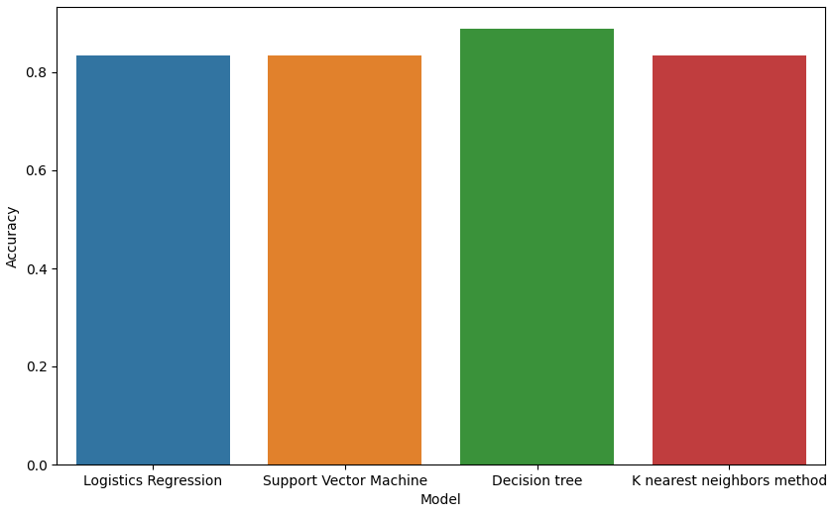
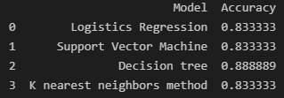
Classification Accuracy
The best model is the Decision Tree with an accuracy of 88.8%.

Slide 45
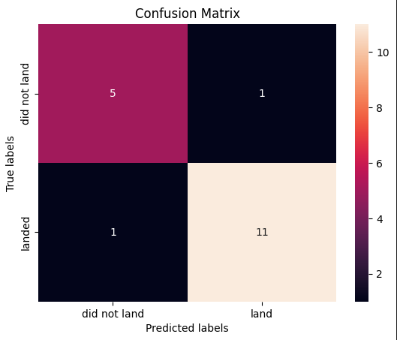
Confusion Matrix for Decision Tree
The model correctly predicts that 5 launches did not land and 11 launches land.

Slide 46
Conclusions
KSC LC 39A is the most successful launch site with 76.9%.
SSO and VLEO orbit have the best chance of a successful launch.
Payloads lower than 4000 have a higher probability to success in SSO orbit.
For orbit VLEO, payloads greater than 13000 have a higher probability to success.
The best classification model to predict the outcome is Decision Tree.

Slide 47


